Slide 1
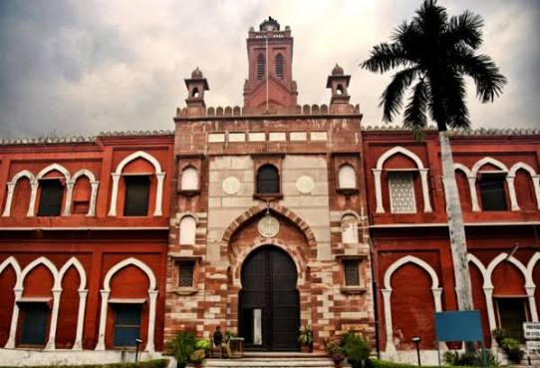

ALIGARH MUSLIM UNIVERSITY
AMU
CHRONICLE
Voices, Stories & Achievements of a Living Legacy
Convocation 2026: A New Chapter Begins
IT Fest Special: Innovation on Campus
Alumni Spotlight: Changing the World
VOL. 42 | ISSUE 01 | 2026

